Slide 1

Cameras
Alex Mariakakis
University of Toronto
Department of Computer Science

Slide 2
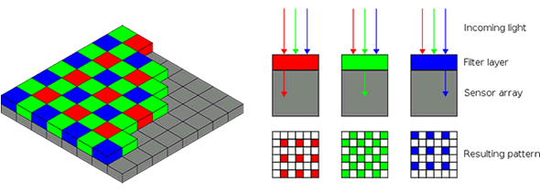
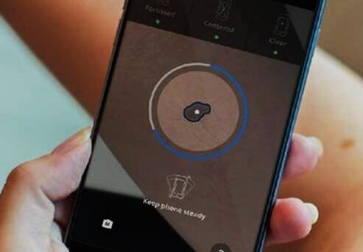
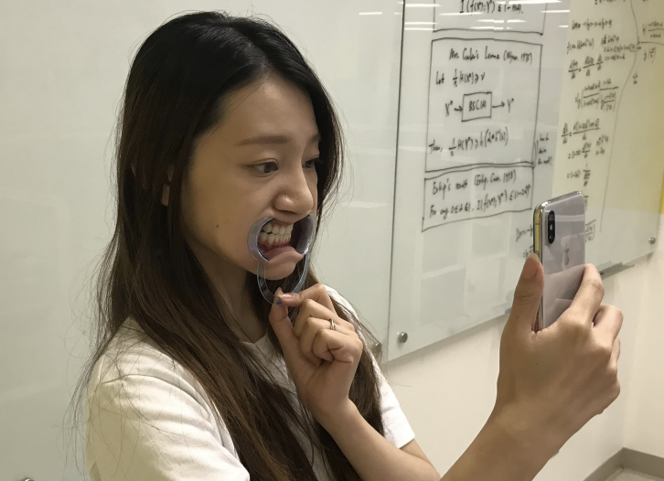
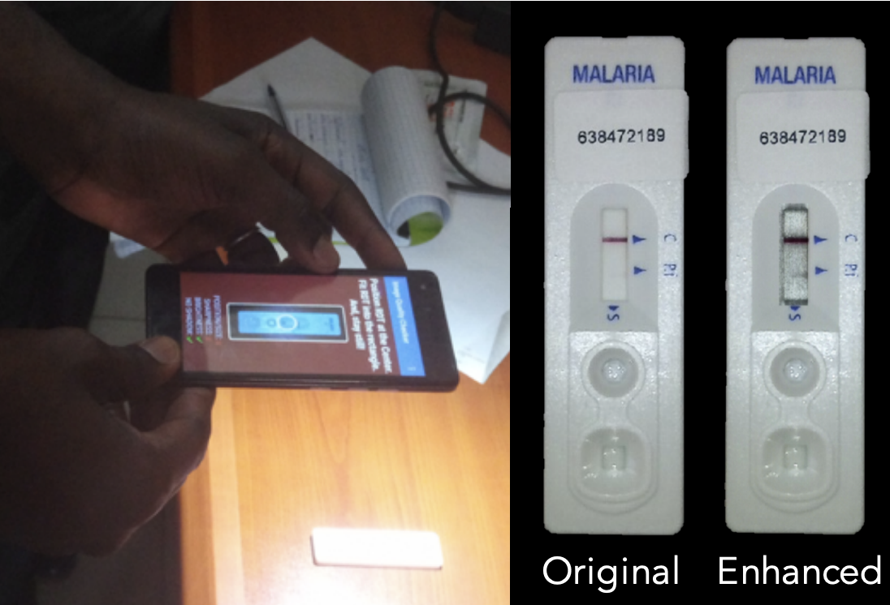
Standard RGB Smartphone Cameras
Purpose Capture scenes according to three “distinct” wavelengths of light (red, green, blue)
Techniques
Bayer filter array + demosaicing
Example mHealth Applications
Skin cancer screening
Oral health monitoring
Diagnostic test reading

Slide 3
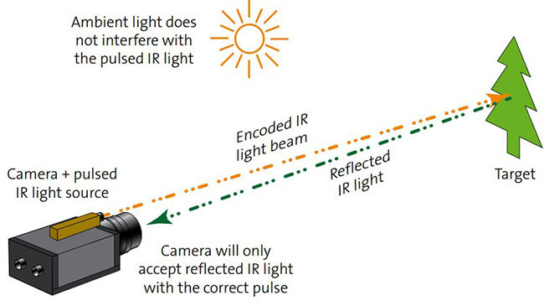
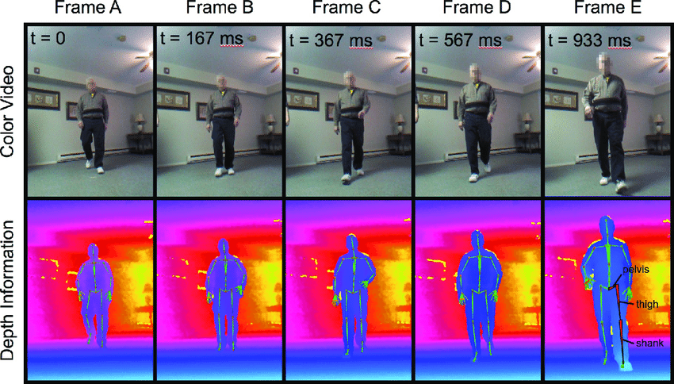
More Than Just RGB: Depth
Purpose
Measures how far away objects are within a scene
Techniques
Structured light: Project a pattern in IR and measure how the scene distorts it
Stereo: Measures disparity between two cameras separated by a short distance (like our eyes)
Time-of-flight: Measures the time it takes for a pulsed light to be reflected back
Example mHealth Applications
Range-of-motion measurement
Gait analysis

Slide 4
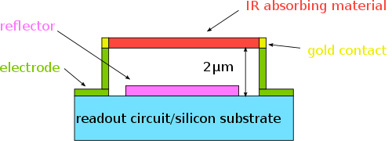
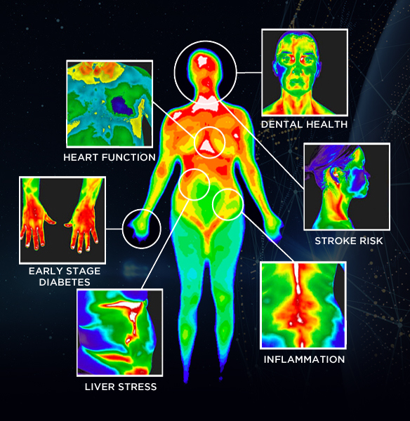
More Than Just RGB: Thermal
Purpose
Measures radiant heat from distant objects
Techniques
Microbolometer pixels absorb IR wavelengths (7.5–14 μm) and change their resistance
Example mHealth Applications
Inflammation detection
Fever screening

Slide 5
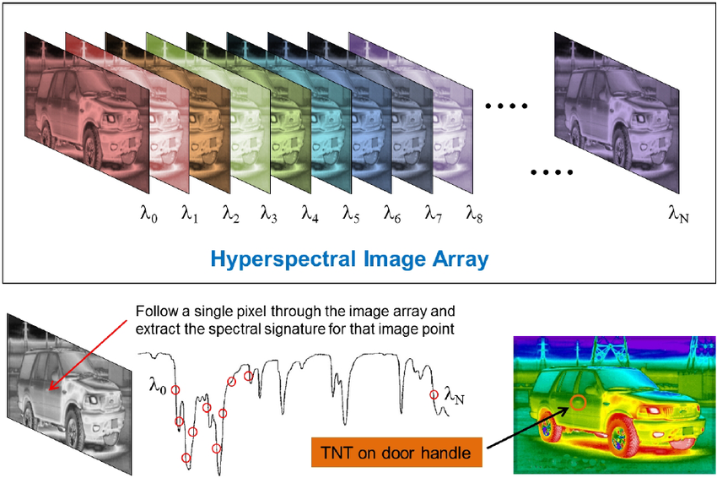
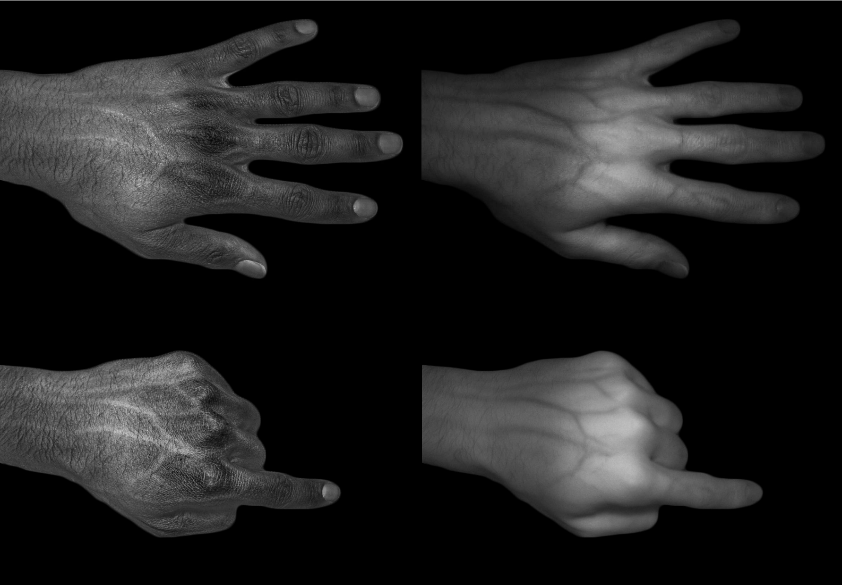
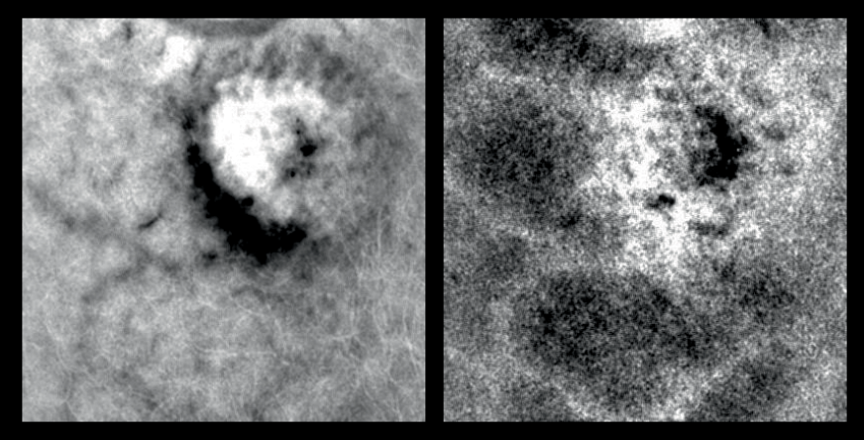
More Than Just RGB: Hyperspectral / Multispectral
Purpose Captures scenes at multiple wavelengths (visible + IR)
Techniques
Active: Sweep through different LEDs
Passive: Sweep through different filters
Example mHealth Applications
Vein localization
Blood oxygen saturation in fingertips, eyes, etc.
Bruise analysis

Slide 6
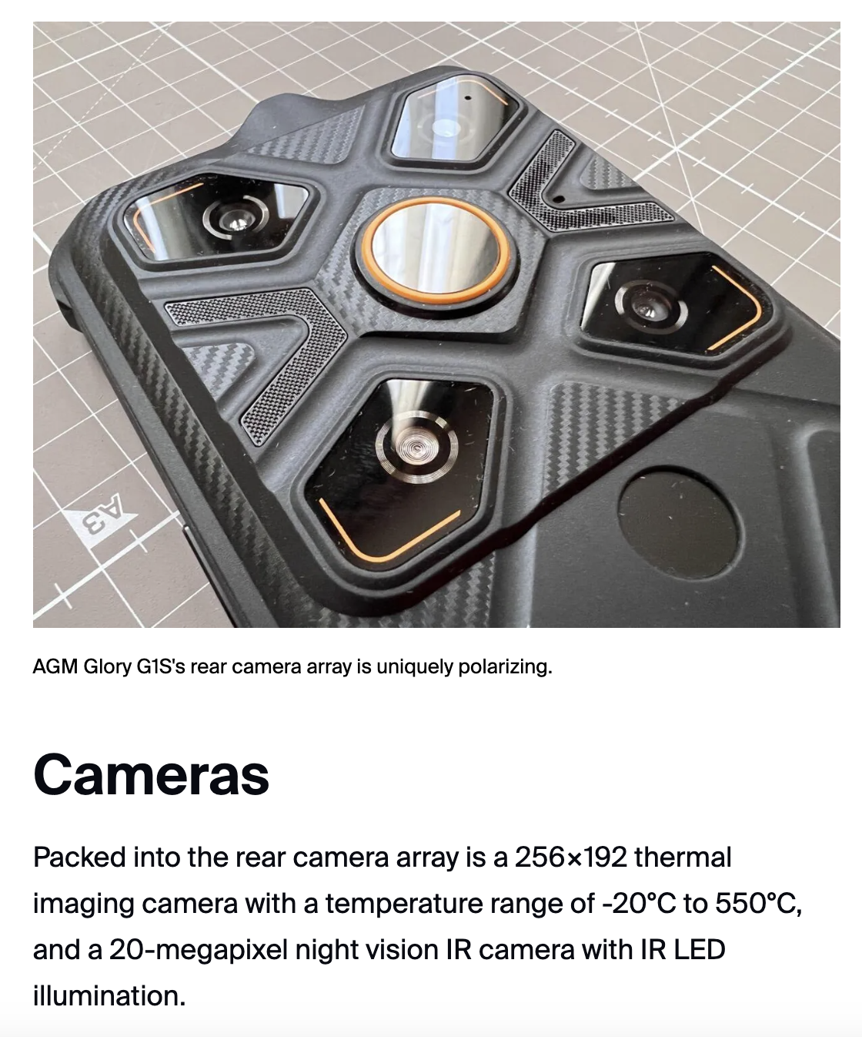
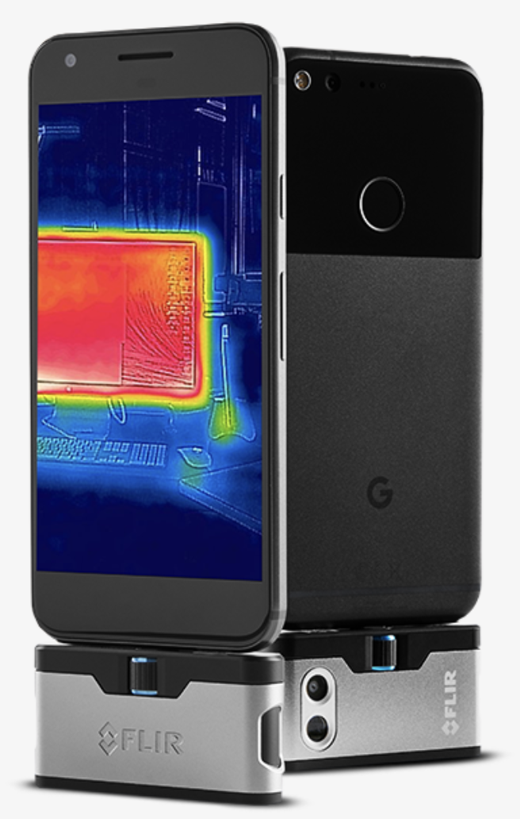
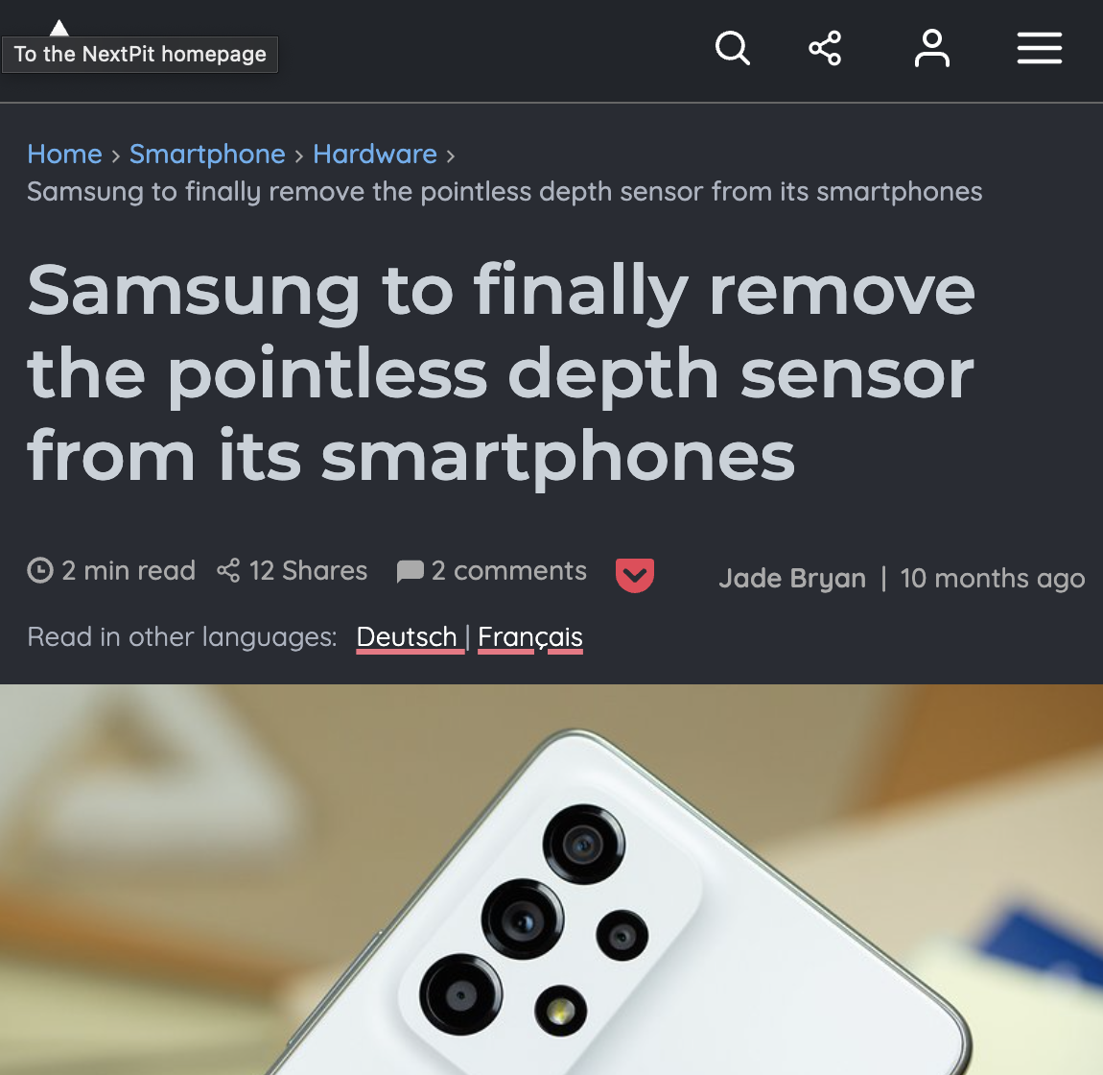
Where Are The Smartphones?
Sophisticated cameras have occasionally made their way into specific smartphone models
Smartphone hardware is often driven by consumer demand, but what are the “killer apps” and are they worth the cost?

Slide 7
Resources
Why You Need an Android Smartphone with a Thermal and IR Camera (ZDNET ‘22)
Medical Hyperspectral Imaging: A Review (Lu and Fei ‘14)

